Slide 1

Stage 4 – Testing
Group 2 - EventHub
202412079 - Rajvi Khatri (Team Lead )
202412013 - Parth Chauhan
202412026 - Tisha Jain
202412029 - Preksha Joshi
202412032 - Kaival Shah
202412066 - Dhruv Patel
202412101 - Yashvi Shah
202412119 - Ritik Kalal

Slide 2

Testing & QA: Verification, Validation, and Robustness
Our objective is to evaluate the verification, validation, and overall robustness of our web booking and payment system. This includes ensuring system reliability across unit, integration, and system-level testing, specifically focusing on core business flows: authentication, booking, payment, and review processes.

Slide 3



Day 4 – Testing & QA: Verification, Validation, and Robustness
Today's objective is to thoroughly evaluate the verification, validation, and inherent robustness of our web booking and payment system. We will cover these critical aspects across unit, integration, and system-level testing to ensure our application performs reliably and meets user expectations.
Verification
Validation
Robustness
Confirming that the product is built according to specifications and design.
Ensuring that the product meets the user's needs and business requirements.
Assessing the system's ability to handle errors gracefully and maintain functionality under diverse conditions.
This evaluation will specifically focus on the core business flows within our system: authentication (auth) → booking → payment → review.

Slide 4

Testing Strategy & Coverage
Our testing strategy employs a multi-layered approach, ensuring comprehensive coverage from the smallest components to the full end-to-end user experience. We leverage Jest for isolated and repeatable test runs.
1
2
Unit Tests
Integration Tests
Model validation, User model hashing tests.
Endpoints + middleware + DB using Jest + mongodb-memory-server.
3
System Tests
End-to-end flows, manual exploratory testing.
Our setup using tests/setup.js and tests/seedData.js enables consistent and deterministic test fixtures.

Slide 5
Test Cases & Representative Results
We've implemented a suite of test cases covering crucial functionalities. Here are representative test cases and specific results from our 2025-11-17 test run.
Key Areas Tested
Test Run Summary (2025-11-17)
Authentication: Register, login, and OTP flows.
Total Suites: 6Tests Passed: 136Tests Failed: 0Duration: ~117.5s
Events: Creation, modification, and deletion.
Bookings: Creation, cancellation, and availability checks.
Payments: Order creation and signature verification.
Reviews: Submission and retrieval.
Code Coverage
Users: Profile management and permissions.
Statements: 70.62%
Branches: 51.46%
Functions: 79.76%
Lines: 70.40%
Detailed logs and coverage reports are available in the coverage/lcov-report directory.

Slide 6
Bug Tracking & Test Artifacts
Effective bug tracking is crucial for maintaining code quality. We use a standardized bug template to ensure clear, actionable issue reporting, complemented by a suite of generated test artifacts.
Bug Template Fields
Generated Artifacts
ID & Severity
test-run-summary.json
Reproduction Steps
test-run-summary.md
Expected vs. Actual Outcome
Coverage Reports
Attachments (screenshots, logs)
Updated Test Files
These artifacts provide comprehensive documentation of our testing efforts, facilitating transparent communication and rapid issue resolution.

Slide 7

Performance & Security Plan
We established a plan for system performance and security, focusing on baseline smoke tests and regular scans to identify vulnerabilities and ensure stability.
Performance
Security
Baseline Smoke Tests: Implement with Artillery/k6.
Dependency Scans: Utilize npm audit and snyk test for third-party library vulnerabilities.
Target RPS: 100 RPS on POST /api/bookings for initial load testing.
Web Application Scans: Regular OWASP ZAP scans for common web application vulnerabilities.

Slide 8
What We Did & Decisions Made
Our focus during this phase was not just on identifying issues, but on actively refining our testing process and ensuring its effectiveness within our continuous integration pipeline.
Executed Comprehensive Test Suite: Ran the full suite of unit, integration, and system tests against the application.
Generated Coverage Reports: Produced detailed code coverage reports to identify areas needing more robust testing.
Made Test Adjustments for CI Stability: Regularly adjusted and optimized tests to prevent false positives and maintain a stable, reliable Continuous Integration environment.
Prioritized Keeping Automated Tests Green: Emphasized fixing broken tests immediately to ensure confidence in our automated checks and prevent accumulation of technical debt.
Documented Key Learnings: Recorded insights from test failures and successes to inform future development and testing strategies.

Slide 9
Local Setup & Artifacts
This section provides a quick guide on how to run tests locally and where to locate the generated testing artifacts.
Running Tests Locally
To set up and run the test suite on your local machine, follow these commands:
npm install
npm test
npm run coverage
These commands will install project dependencies, execute the test suite, and generate comprehensive code coverage reports.
Generated Test Artifacts
After running the tests, various artifacts are generated for review and can be found in the following locations:
Test_Plan.md: Comprehensive test plan document outlining scope and strategy.
Test_Report.md: Detailed summary of the latest test run, including results.
Sample_Test_Data.json: Data utilized for deterministic test fixtures.
test-run-summary.json & test-run-summary.md: Machine-readable and human-readable summaries of the test execution.
coverage/lcov-report/index.html: Interactive HTML report detailing code coverage statistics.

Slide 10

Q&A / Artifacts
Thank you for your attention. We are now open for any questions you may have. Additionally, all relevant testing documentation and reports are readily accessible for your review.
Test Plan: backend/testing_docs/Test_Plan.md
Test Report: backend/testing_docs/Test_Report.md
Sample Test Data: backend/testing_docs/Sample_Test_Data.json
Test Run Summary (JSON): backend/testing_docs/test-run-summary.json
Test Run Summary (Markdown): backend/testing_docs/test-run-summary.md
Coverage Reports (HTML): coverage/
Feel free to explore these resources and run tests locally to gain a deeper understanding.

Slide 11
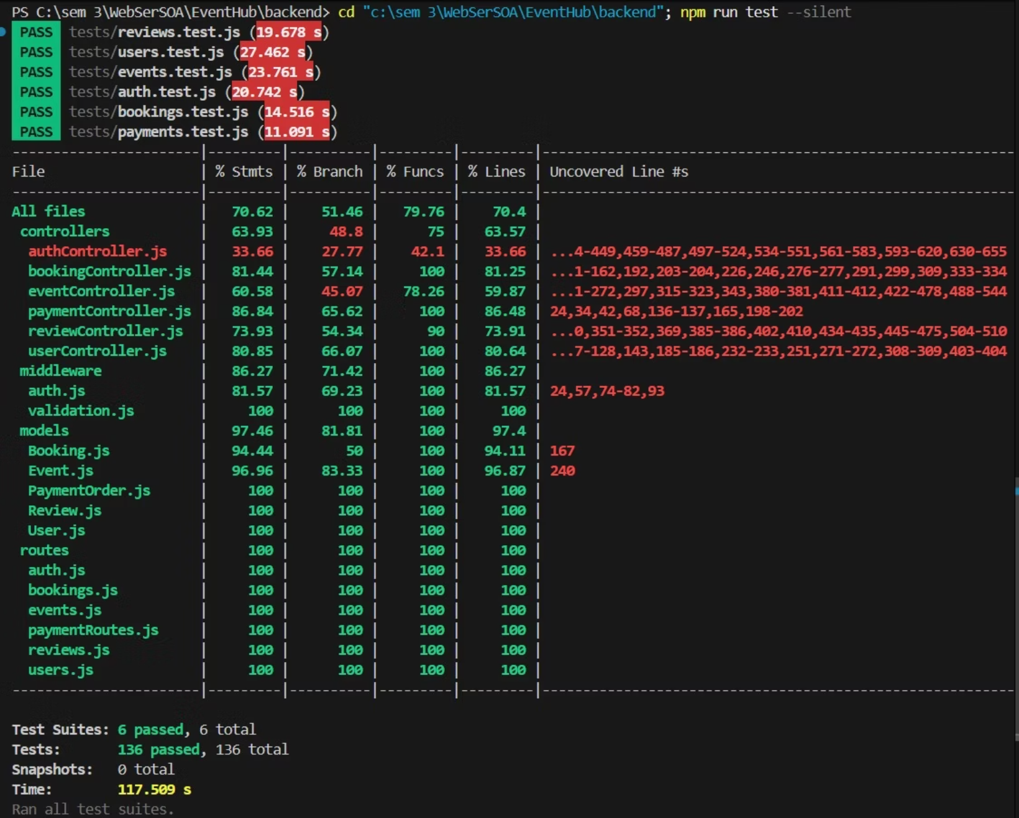
Automated test suite: 136/136 passed (Statements 70.62%, Branches 51.46%)
— verification, validation and system robustness confirmed for auth → booking → payment flows.

Slide 12

Thank You
for your attention!
Questions?
We appreciate your engagement and welcome any questions you may have regarding our testing presentation.

